Slide 1
I/O Models & Domain Name System
Blocking, Non-blocking, Signal-driven, Asynchronous I/O and Multiplexing
Chapter 6 and 16
Domain Name System, Resource records, Resolvers, Name and Address Conversions
Chapter 11

Slide 2
I/O Multiplexing
When a client or server handles multiple descriptors.
File,
Socket,
STDIN/STDOUT
Handle blocking

Slide 3
I/O Models
Blocking I/O
Nonblocking I/O
I/O multiplexing (select and poll)
Signal driven (SIGIO)
Asynchronous I/O (POSIX aio_ functions)

Slide 4
Blocking I/O
application
kernel
recvfrom
System call
No datagram ready
Wait for data
Datagram ready
Copy datagram
Process blocks in
call to recvfrom
Copy data from
Kernel to user
Return OK
Process datagram
Copy complete

Slide 5
Nonblocking I/O
application
kernel
recvfrom
System call
No datagram ready
EWOULDBLOCK
recvfrom
System call
No datagram ready
EWOULDBLOCK
Wait for data
recvfrom
System call
No datagram ready
EWOULDBLOCK
Process repeatedly
calls recvfrom, waiting
for an OK return (polling)
recvfrom
System call
No datagram ready
EWOULDBLOCK
recvfrom
System call
Datagram ready
Copy datagram
Copy data from
Kernel to user
Return OK
Process datagram
Copy complete

Slide 6
I/O Multiplexing Model
application
kernel
select
System call
No datagram ready
Process blocks in call
to select, waiting
for possibly many
sockets to become
readable.
Wait for data
Datagram ready
Return readable
recvfrom
System call
Datagram ready
Copy datagram
Copy data from
Kernel to user
Process blocks while
data copied into
application buffer
Return OK
Process datagram
Copy complete

Slide 7
Signal Driven I/O Model
application
kernel
system call
aio_read
No datagram ready
return
Process continues
to execute
Wait for data
Datagram ready
signal handler
Deliver SIGIO
recvfrom
System call
Datagram ready
Copy datagram
Copy data from
Kernel to user
Process blocks while
data is copied
into application
buffer
Return OK
Process datagram
Copy complete

Slide 8
Asynchronous I/O Model
application
kernel
Sigaction system call
aio_read
No datagram ready
return
Process continues
to execute
Wait for data
Datagram ready
Copy datagram
Copy data from
Kernel to user
Signal handler
Process datagram
Deliver signal
Specified in
aio_read
Copy complete

Slide 9
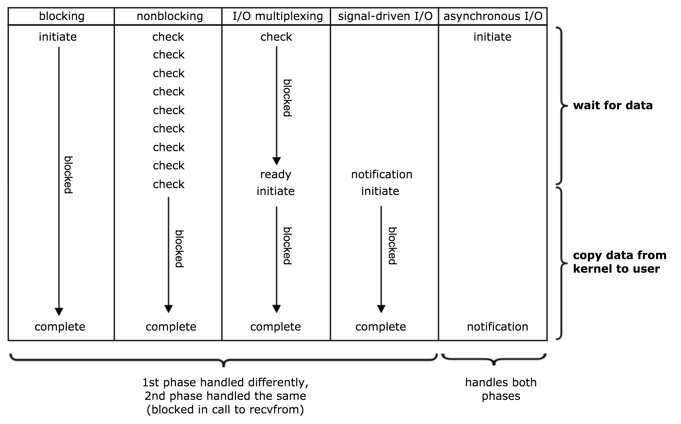
Comparison of the five I/O Models
A synchronous I/O operation causes the requesting process to be blocked until the I/O operation completes.
An asynchronous I/O operation does not cause the requesting process to be blocked.

Slide 10
Select
No File descriptors to test + 1
#include <sys/select.h>
#include <sys/time.h>
int socket(int maxfdp1,
fd_set *readset, fd_set *writeset,fd_set *exceptset,
const struct timeval *timeout);
struct timeval {
long tv_sec;
long tv_usec;
};
Returns: positive count of ready descriptors, 0 on timeout, -1 on error.
Ready for reading
Wait forever, timeout -> NULL
Wait until timeout
Do not wait, timeout={tv_sec=0;tv_usec=0;}
Ready for writing
Has an exception pending

Slide 11
Descriptor Sets
“Usually an array of integers, with each bit in each integer corresponding to a descriptor.”
void FD_ZERO(fd_set *fdset);
void FD_SET(int fd, fd_set *fdset);
void FD_CLR(int fd, fd_set *fdset);
int FD_ISSET(int fd, fd_set *fdset);
Int FD_SETSIZE(); /* 1024 Linux */

Slide 12
Select
Create the set
FD_ZERO()
FD_SET(a)
FD_SET(b)
Select
FD_ISSET(a) = false
FD_ISSET(b) = true

Slide 13

What does ‘Ready’ mean?
Socket is ready for reading if:
No. bytes in Socket Buffer >= low-water mark (SO_RCVLOWAT)
Default is 1 byte for UDP/TCP sockets.
The read half is closed.
Read would not block and return 0.
It’s a listening socket, No. completed conns. >0.
Accept would not block. However, in the details there can be issues.
A Socket Error is pending.
Read would not block but return -1.

Slide 14
What does ‘Ready’ mean?
Socket is ready for writing if:
No. bytes available space in Socket Send Buffer >= low-water mark (SO_SNDLOWAT), and i) Socket is connected (TCP) or ii) Socket does not require a connection (UDP).
Default is 2048 byte for UDP/TCP sockets.
The write half is closed.
Write would generate SIGPIPE.
A socket using non-blocking connect has completed the connection, or the connect has failed.
A Socket Error is pending.
Write would not block but return -1.

Slide 15
Summary
Condition | Readable | Writable | Exception
Data to read Read-half of connection closed New connection ready for listening socket | X X X
Space available for writing Write-half of the connection closed |  | X X
Pending error | X | X
TCP out-of-band data |  |  | X

Slide 16
Example: str_cli
FD_ZERO(&rset);
for ( ; ; ) {
FD_SET(sockfd, &rset);
maxfdp1 = max(fileno(fp), sockfd) + 1;
Select(maxfdp1, &rset, NULL, NULL, NULL);
if (FD_ISSET(sockfd, &rset)) { /* socket is readable */
if (Readline(sockfd, recvline, MAXLINE) == 0) {
err_quit("str_cli: server terminated prematurely");
}
Fputs(recvline, stdout);
}
if (FD_ISSET(fileno(fp), &rset)) { /* input is readable */
if (Fgets(sendline, MAXLINE, fp) == NULL) {
return;
}
Writen(sockfd, sendline, strlen(sendline));
}
}

Slide 17
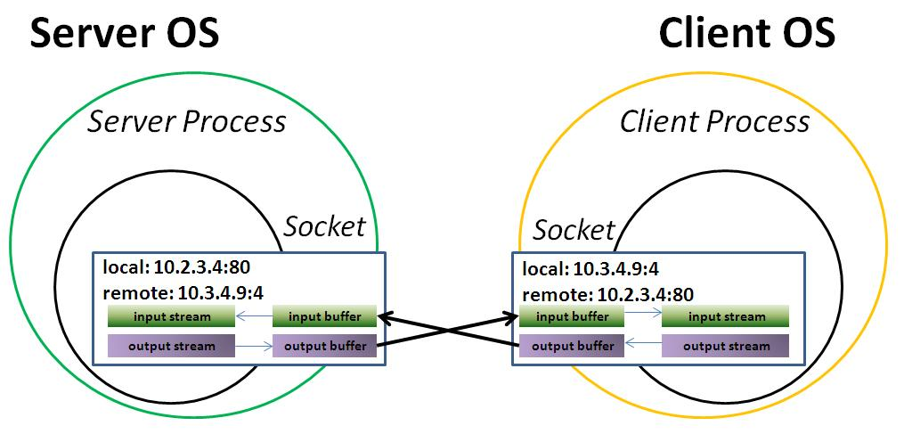
Batch Input and Buffering Select & stdio
Select
– Only IF, not how much –

Slide 18
Shutdown
#include <sys/socket.h>
int shutdown(int sockfd, int howto);
Value | Description
SHUT_RD | The Read half of the connection is closed.
SHUT_WR | The Write half of the connection is closed.
SHUT_RDWR | The read and write half of the connection is closed. Equivalent of calling shutdown twice, first RD the WR.

Slide 19
TCP Echo Server (revisited)
External Viewer
tcp_select_server.c
for ( ; ; ) {
rset = allset; /* structure assignment */
nready = Select(maxfd+1, &rset, NULL, NULL, NULL);
if (FD_ISSET(listenfd, &rset)) { /* new client connection */
clilen = sizeof(cliaddr);
connfd = Accept(listenfd, (SA *) &cliaddr, &clilen);
for (i = 0; i < FD_SETSIZE; i++)
if (client[i] < 0) {
client[i] = connfd; /* save descriptor */
break;
}
if (i == FD_SETSIZE)
err_quit("too many clients");
FD_SET(connfd, &allset); /* add new descriptor to set */
if (connfd > maxfd)
maxfd = connfd; /* for select */
if (i > maxi)
maxi = i; /* max index in client[] array */

Slide 20
TCP Echo Server (revisited)
if (--nready <= 0)
continue; /* no more readable descriptors */
}
for (i = 0; i <= maxi; i++) { /* check all clients for data */
if ( (sockfd = client[i]) < 0)
continue;
if (FD_ISSET(sockfd, &rset)) {
if ( (n = Read(sockfd, buf, MAXLINE)) == 0) {
/*connection closed by client */
Close(sockfd);
FD_CLR(sockfd, &allset);
client[i] = -1;
} else
Writen(sockfd, buf, n);
if (--nready <= 0)
break; /* no more readable descriptors */
}
}
}
External Viewer
tcp_select_server.c

Slide 21
The Select Race
if (intr_flag)
handle_intr(); /* handle the signal */
/* signals occurring in here are lost */
if ( (nready = select( ... )) < 0) {
if (errno == EINTR) {
if (intr_flag)
handle_intr();
}
...
}

Slide 22
pselect
#include <sys/select.h>
#include <signal.h>
#include <time.h>
int pselect(int nfds,
fd_set *readfds, fd_set *writefds, fd_set *exceptfds,
const struct timespec *timeout,
const sigset_t *sigmask);
struct timeval {
long tv_sec;
long tv_nsec;
};
Identical to select,
different timeout capabilities
SIGMASK, to block ‘signals’ during test (avoid race).

Slide 23
pselect approach
sigset_t newmask, oldmask, zeromask;
sigemptyset(&zeromask);
sigemptyset(&newmask);
sigaddset(&newmask, SIGINT);
sigprocmask(SIG_BLOCK, &newmask, &oldmask); /* block SIGINT */
if (intr_flag)
handle_intr(); /* handle the signal */
if ( (nready = pselect ( ... , &zeromask)) < 0) {
if (errno == EINTR) {
if (intr_flag)
handle_intr ();
}
...
}

Slide 24
poll / ppoll
#include <poll.h>
int poll(struct pollfd *fdarray, unsigned long nfds, in timeout);
int ppoll(struct pollfd *fds, nfds_t nfds,
const struct timespec *timeout_ts,
const sigset_t *sigmask);
poll and ppoll like select and pselect.
struct pollfd {
int fd; /* Descriptor to test */
short events; /* events of interest on fd */
short revents; /* events that occurred on fd */
};

Slide 25
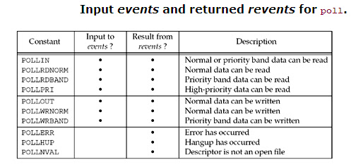

Slide 26
epoll (Linux Specific)
Epoll is a kernel data struct, not a system call cf. Poll, Select.
https://jvns.ca/blog/2017/06/03/async-io-on-linux--select--poll--and-epoll/

Slide 27
Domain Name System
Domain Name System, Resource records, Resolvers, Name and Address Conversions
Chapter 11

Slide 28
DNS
Translates / maps between strings and IP addresses
Forward lookup:
www.example.com ➔ 192.0.2.44
Reverse lookup:
192.0.2.44 ➔ www.example.com

Slide 29
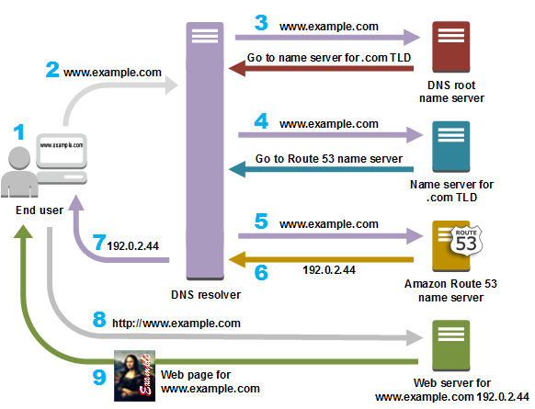

Slide 30
Name types
Simple name
Vdicli
Fully Qualified Domain Name (FQDN)
vdicli.lontas.nplab.bth.se

Slide 31
Resource Records
A Maps hostname to IPv4
AAAA Maps hostname to IPv6
PTR Pointer to a hostname (reverse lookup)
MX Specifies a host as a mail exchange
CNAME Canonical name, maps a hostname to another.

Slide 32
Pointer Records -- PRT
Used for reverse lookup
IPv4
192.0.2.44 → 44.2.0.192.in-addr.arpa
IPv6
2001:db8::567:89ab → b.a.9.8.7.6.5.0.0.0.0.0.0.0.0.0.0.0.0.0.0.0.0.0.8.b.d.0.1.0.0.2.ip6.arpa.

Slide 33
CNAME
NAME TYPE VALUE
--------------------------------------------------
bar.example.com. CNAME foo.example.com.
foo.example.com. A 192.0.2.23
www.example.com. CNAME foo.example.com

Slide 34
Resolvers and Name Servers
Application
code
Local name server
Other name servers
Resolver
code
Resolver config files

Slide 35
Caching
Application
code
Local name server
Other name servers
Resolver
code
Resolver config files

Slide 36
BIND
A common Name server
Initial release early 1980s
https://gitlab.isc.org/isc-projects/bind9.git
Fully compliant IETF DNS standards and draft standards

Slide 37
Forward lookup
#include <netdb.h>
struct hostent *gethostbyname (const char *hostname);
// DEPRECATED
struct hostent {
char *h_name;
char **h_aliases;
int h_addrtype;
int h_length;
char **h_addr_list;
}
Requests A record
Included as 90% of the solutions use it..

Slide 38
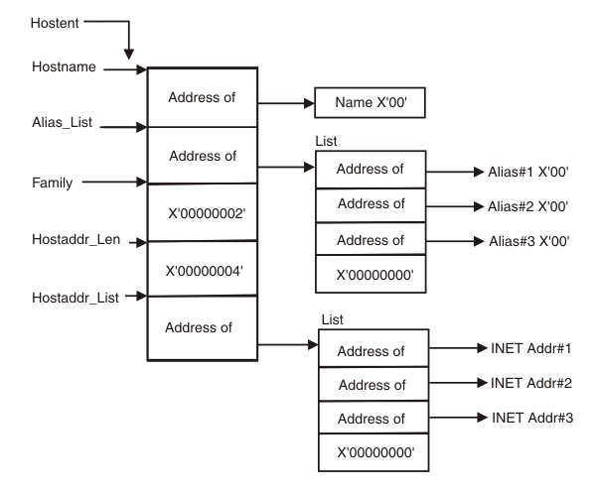
struct hostent

Slide 39
int main(int argc, char **argv) {
char *ptr, **pptr;
char str[INET_ADDRSTRLEN];
struct hostent *hptr;
while (--argc > 0) {
ptr = *++argv;
if ( (hptr = gethostbyname(ptr)) == NULL) {
fprintf(stderr,"gethostbyname error for host: %s: %d",ptr, h_errno);
continue;
}
printf("official hostname: %s\n", hptr->h_name);
for (pptr = hptr->h_aliases; *pptr != NULL; pptr++)
printf("\talias: %s\n", *pptr);
switch (hptr->h_addrtype) {
case AF_INET:
pptr = hptr->h_addr_list;
for ( ; *pptr != NULL; pptr++)
printf("\taddress: %s\n",
inet_ntop(hptr->h_addrtype, *pptr, str, sizeof(str)));
break;
default:
perror("unknown address type");
break;
}
}
exit(0);
}
struct hostent {
char *h_name;
char **h_aliases;
int h_addrtype;
int h_length;
char **h_addr_list;
}
https://github.com/patrikarlos/networkprogramming hostent

Slide 40
Reverse lookup
#include <netdb.h>
struct hostent *gethostbyaddr(const char *addr, socklen_t len, int family);
Requests PTR record
Pointer to an in_addr structure

Slide 41
Service Resolution
#include <netdb.h>
struct servent *getservbyname(const char *addr, const char *protoname);
struct servent *getservbyport(int port, const char *protoname);
/etc/services
sptr=getservbyname(“ftp”,”tcp”);
sptr=getservbyname(“ftp”,”udp”); //fails
struct servent {
char *s_name;
char **s_aliases;
int s_port;
char *s_proto;
}

Slide 42
getaddrinfo
#include <netdb.h>
int getaddrinfo(const char *hostname, const char *service,
const struct addrinfo *hints, struct addrinfo **result);
IPv4 & IPv6
Name-to-address
Service-to-port
struct addrinfo {
int ai_flags;
int ai_family;
int ai_socktype;
int ai_protocol;
socklen_t ai_addrlen;
char *ai_canonname;
struct sockaddr *ai_addr;
struct addrinfo *ai_next;
}

Slide 43
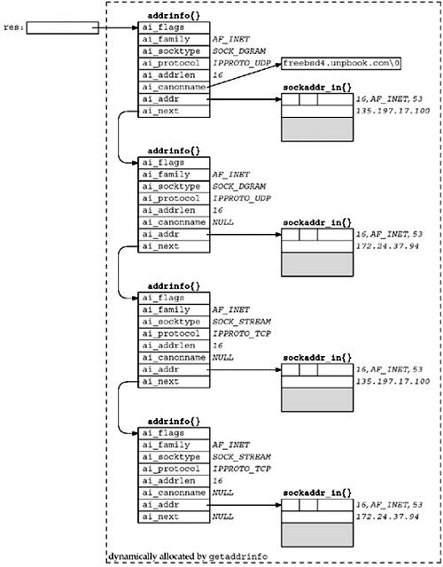
example
bzero(&hints, sizeof(hints));
hints.ai_flags = AI_CANONNAME;
hints.ai_family = AF_INET;
while (--argc > 0) {
ptr = *++argv;
if ( (n = getaddrinfo(ptr, "domain", &hints, &res) ) != 0) {
fprintf(stderr,"getaddrinfo error for host: %s: %s",ptr, gai_strerror(n));
continue;
}
bob = res;
do {
inet_ntop(bob->ai_family,
&((struct sockaddr_in *)bob->ai_addr)->sin_addr,
addrstring,100);
printf(" hostname: %s %s %d %p\n", bob->ai_canonname,
addrstring,bob->ai_protocol, bob->ai_next);
bob = bob->ai_next;
} while (bob != NULL );
}

Slide 44
#include <netdb.h>
const char *gai_strerror(int error);
if ( (n = getaddrinfo(ptr, "domain", &hints, &res) ) != 0) {
fprintf(stderr,"getaddrinfo error for host: %s: %s",ptr, gai_strerror(n));
continue;
}
#include <netdb.h>
Void freeaddrinfo(struct addrinfo *ai);

Slide 45
getnameinfo
#include <netdb.h>
int getnameinfo(const struct sockaddr *sockaddr, socklen_t addrlen,
char *host, socklen_t hostlen,
char *serv, socklen_t servlen, int flags);
IPv4 & IPv6
Address-to-name
Port-to-Service
Constant | Description
NI_DGRAM | Datagram service
NI_NAMEREQD | Return an error if name cannot be resolved
NI_NOFQDN | Return only hostname of FQDN
NI_NUMERICHOST | Return numeric string for hostname
NI_NUMERICSCOPE | Return numeric string for scope id.
NI_NUMERICSERV | Return numeric string for service name.

Slide 46
Re-entrant
Thread issues
theA; gethostbyname() => A.
theB; gethostbyname() => B.
*_r functions
Dep. On calling sequence, A can get “theB” or B get the “theA”.
A
B
B
A
B
A
B
A

